Slide 1
Learning From Non-Parametric ML Algorithms
Shreenidhi Sudhakar

Slide 2
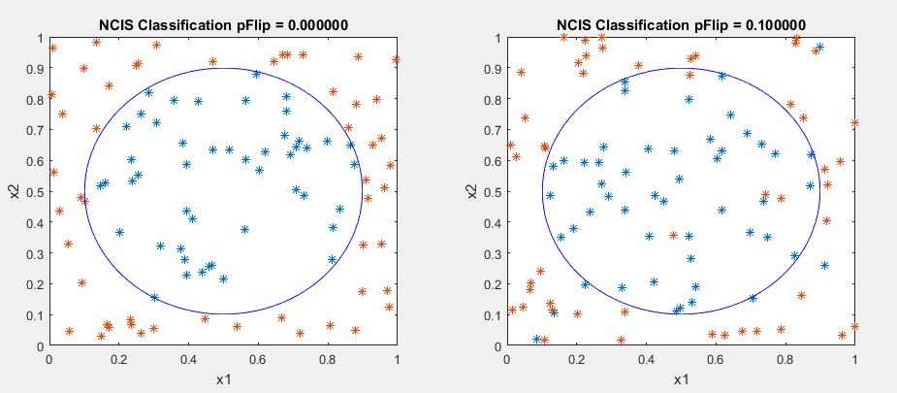
Non-Parametric Models
Time Consuming
Prone to over-fitting
Undefined parameters
Higher chances of accurate predictions
Commonly used models are K-Nearest Neighbor, Parzen Window, Non-Linear Support Vector Machine

Slide 3
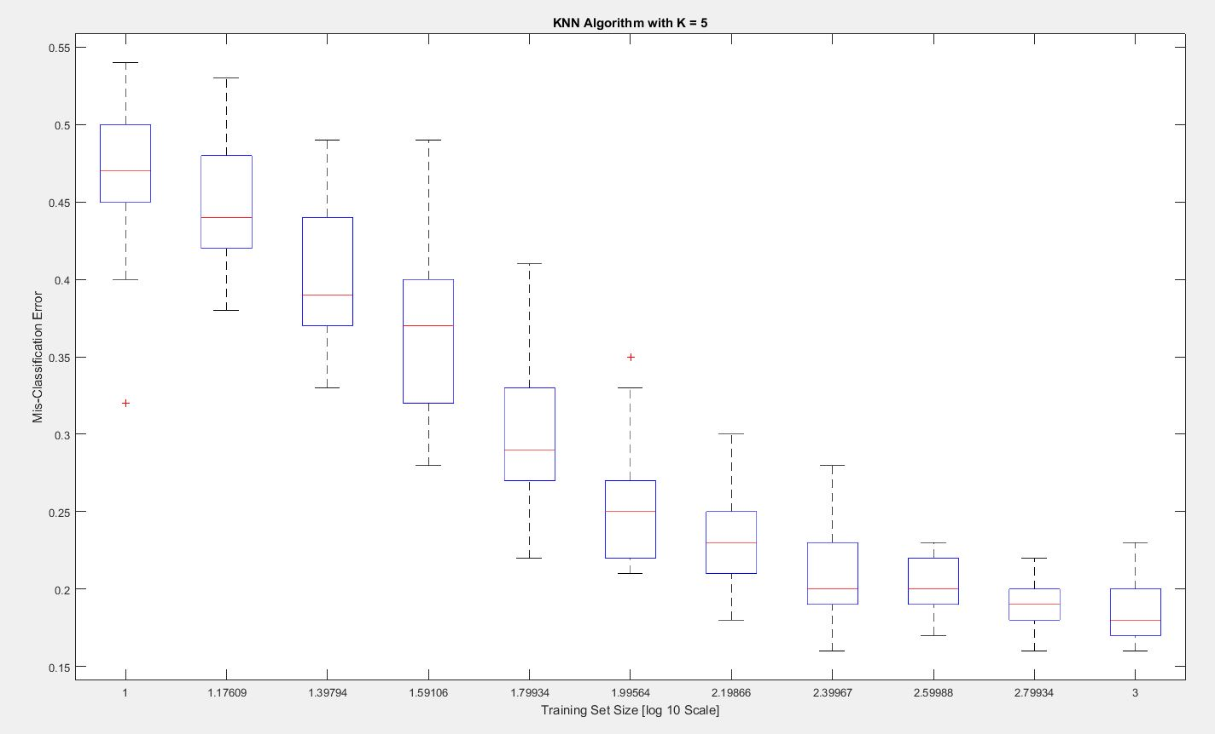
K- Nearest Neighbors

Slide 4
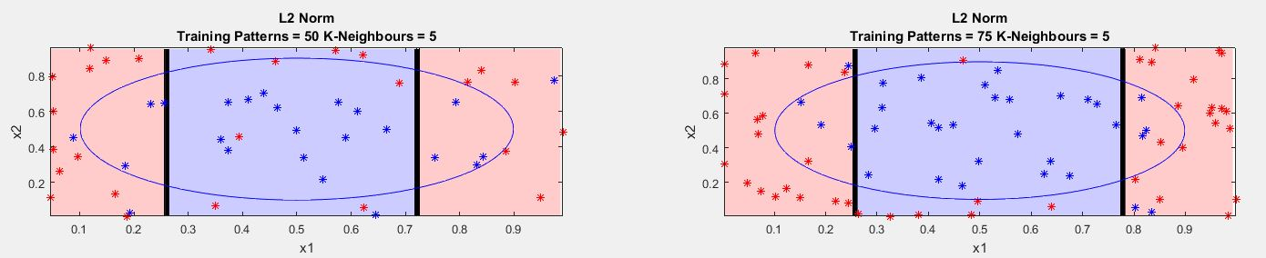
K- Nearest Neighbors

Slide 5
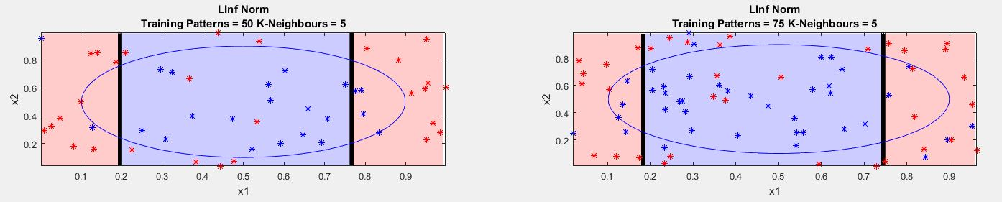
K- Nearest Neighbors

Slide 6
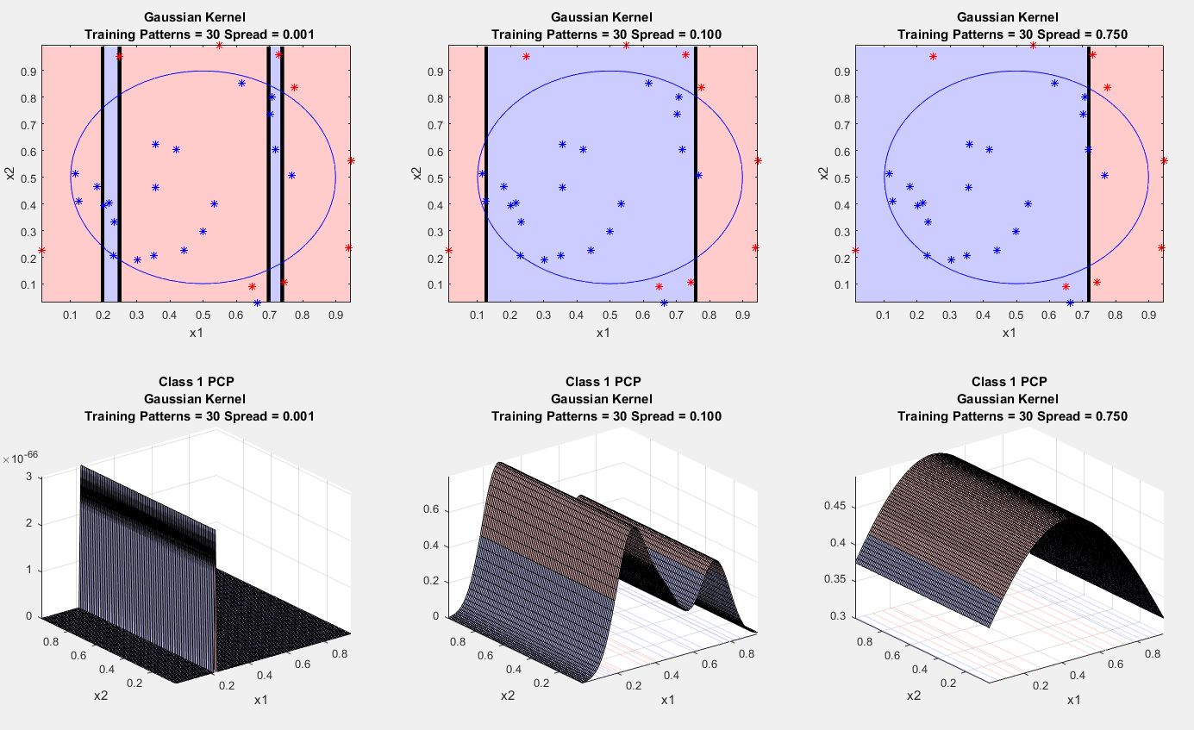
Parzen Window

Slide 7
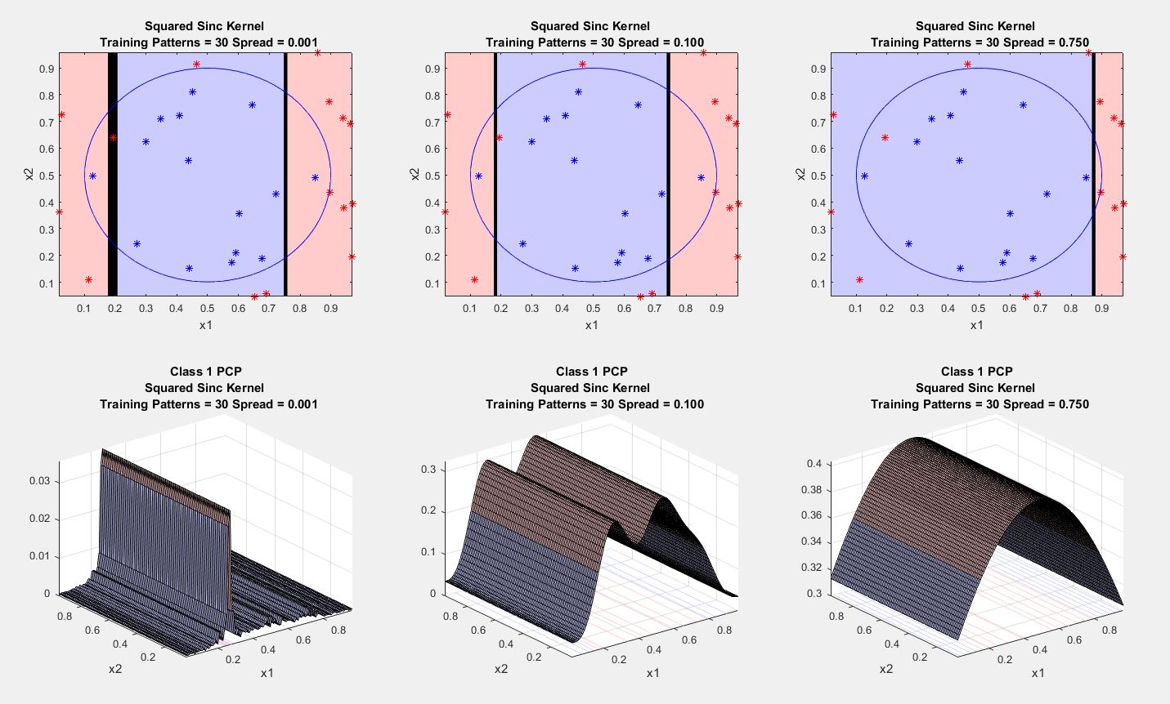
Parzen Window

Slide 8
Real Time Application
Bioinformatics
Image Classification
Text Categorization

Slide 9
Thank You
Check Out: shreenidhi.azurewebsites.net

